Slide 1

Spring 2024
Python ecosystem
Programming and Data Analysis for Modern Neuroscience
NEU 365P/385P
Marcel Goldschen-ohm
Assistant Professor in the Department of Neuroscience, The University of Texas at Austin

Slide 2
Programming: Part of a modern scientist’s toolkit

Slide 3
Being good at programming is NOT simply knowing a lot of program syntax.
It is about…
Understanding a problem conceptually & being able to translate it to code.
Thinking of new ways to tackle a problem and knowing what tools to use.
Knowing how to fix your program when it does not work.
Writing a program that is fast enough, not the fastest possible.
Writing a program that can be understood by other people (or by yourself in a year!)

Slide 4

Learning goals – Python ecosystem
You will understand the role of the Python interpreter.
You will gain a rudimentary understanding of the Python ecosystem.
You will be introduced to the Conda package manager.
You will be introduced to Jupyter notebooks.

Slide 5

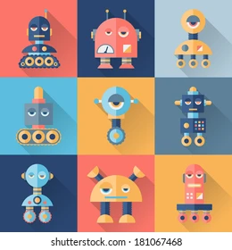
From humans to computers
SOURCE CODE
x = 2
if x > n:
do_stuff()
MACHINE CODE
001010100010101010101010010100101010101010
Write
Compile
Run

Slide 6

Distribute pre-compiled machine code executable (.exe)
PROS
Optimized for specific hardware.
Runs FAST!
SOURCE CODE
x = 2
if x > n:
do_stuff()
MACHINE CODE
001010100010101010101010010100101010101010
Write
Compile
Run
Humans can’t understand this!
Only runs on specific hardware.
CONS
Big problems for scientific data analysis!

Slide 7

Distribute source code & run with an interpreter
Great for scientific data analysis!
PROS
Humans can understand source code.
Runs everywhere with an interpreter.
SOURCE CODE
x = 2
if x > n:
do_stuff()
MACHINE CODE
001010100010101010101010010100101010101010
INTERPRETER
Compiles code on-the-fly as it runs.
Write
Run
Not pre-optimized for specific hardware.
On-the-fly compilation slows speed a bit.
CONS

Slide 8
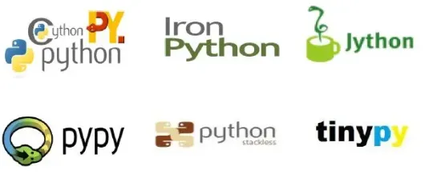
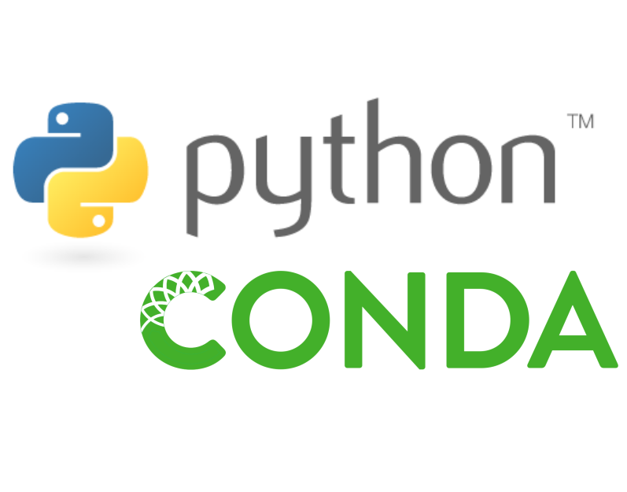
Python = code syntax + interpreter
PYTHON CODE
x = 2
if x > n:
do_stuff()
MACHINE CODE
001010100010101010101010010100101010101010
INTERPRETER
Python 2.x (legacy)
Python 3.x (modern)
Write
Run
flavor
and more…

Slide 9
Sometimes you need optimized machine code
PYTHON CODE
x = 2
if x > n:
do_stuff()
Python
INTERPRETER
Run
What if the interpreter is TOO SLOW for a particularly intensive computation?

Slide 10
Python packages
PYTHON CODE
x = 2
if x > n:
do_stuff()
Python
INTERPRETER
Run
SOURCE CODE
int x = 2;
if (x > n) {
do_stuff();
}
MACHINE CODE
001010100010101010101010010100101010101010
Pre-compiled
package

Slide 11
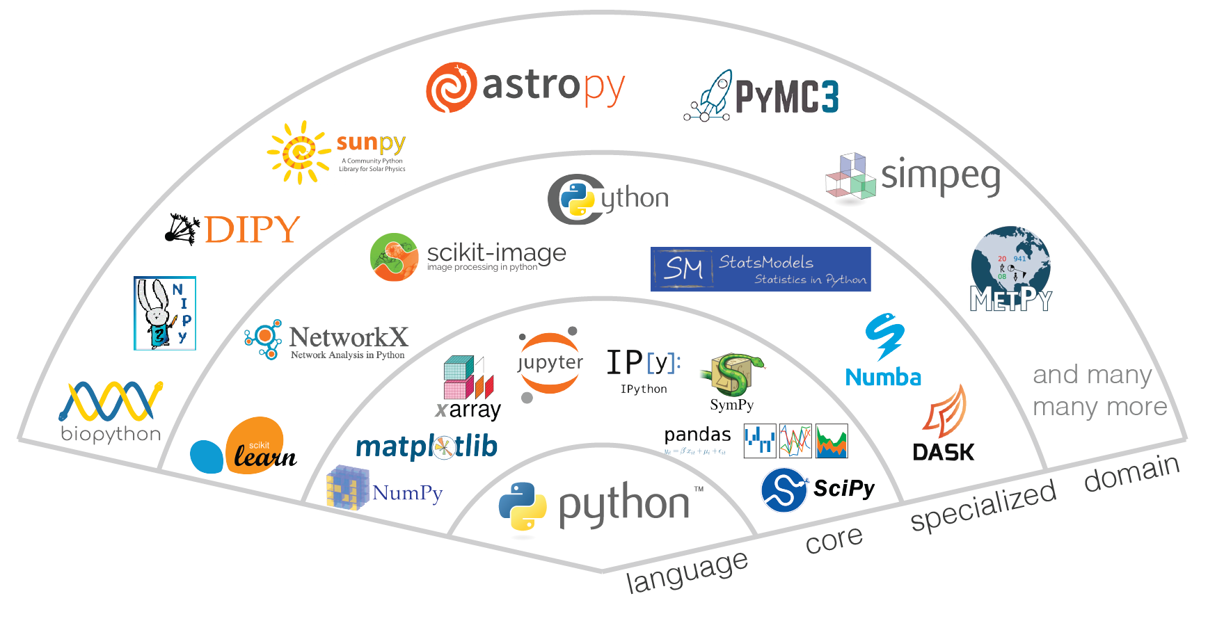
Python data science package ecosystem!
and many more…

Slide 12
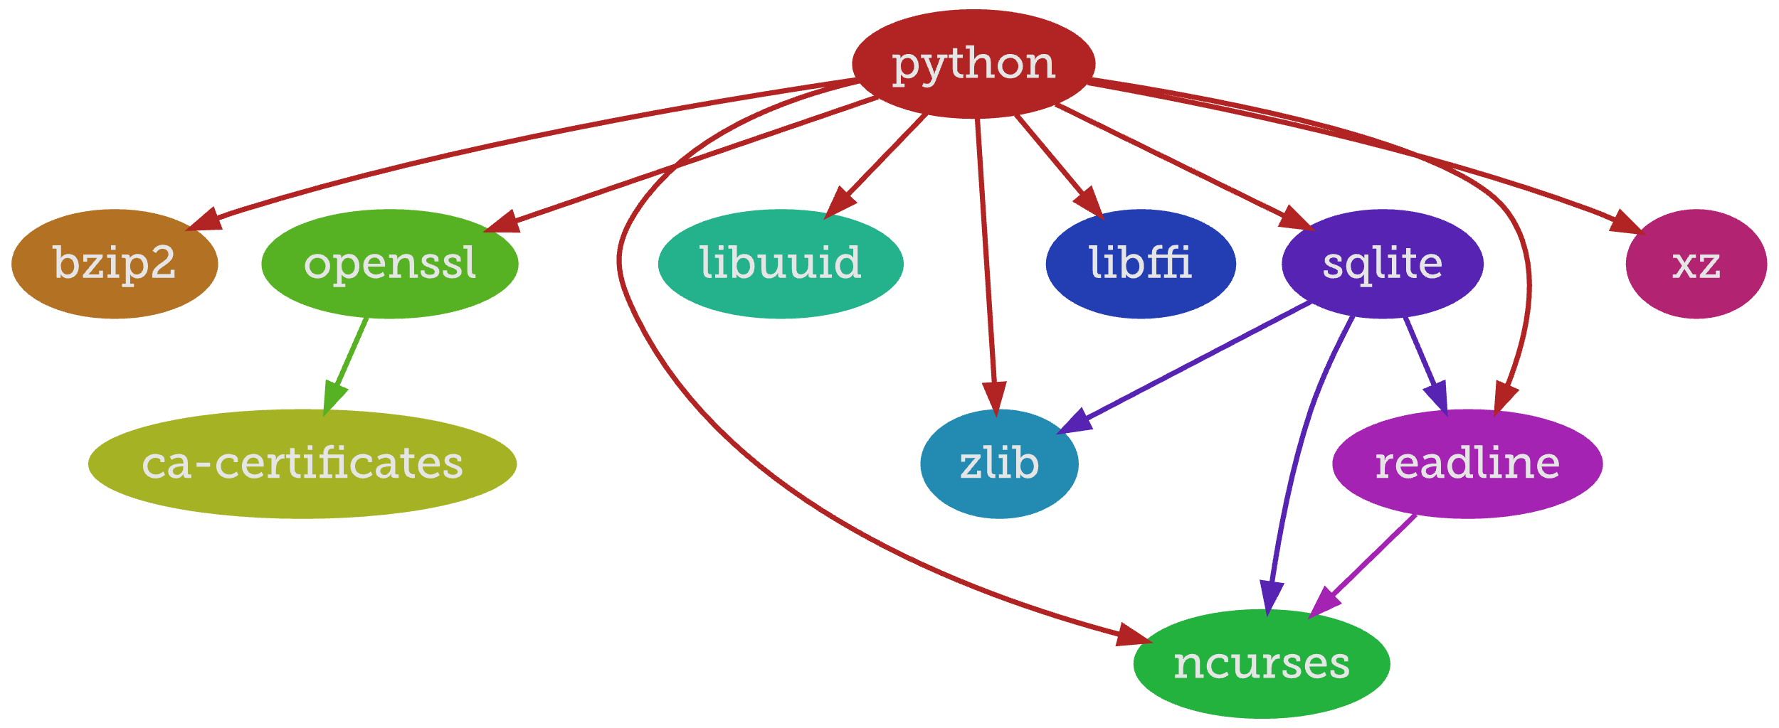
Package dependency graph

Slide 13
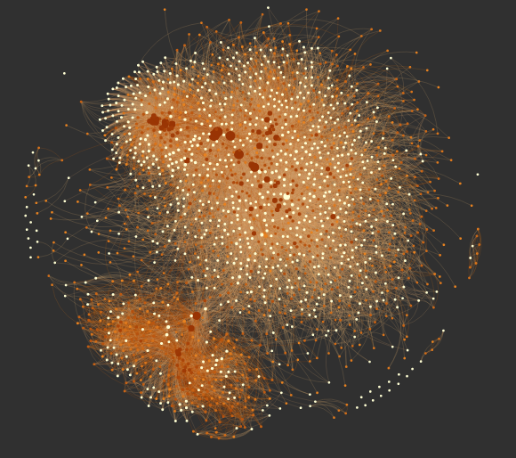
Managing packages is NOT for humans
Python package dependency graph
https://kgullikson88.github.io/blog/pypi-analysis.html

Slide 14
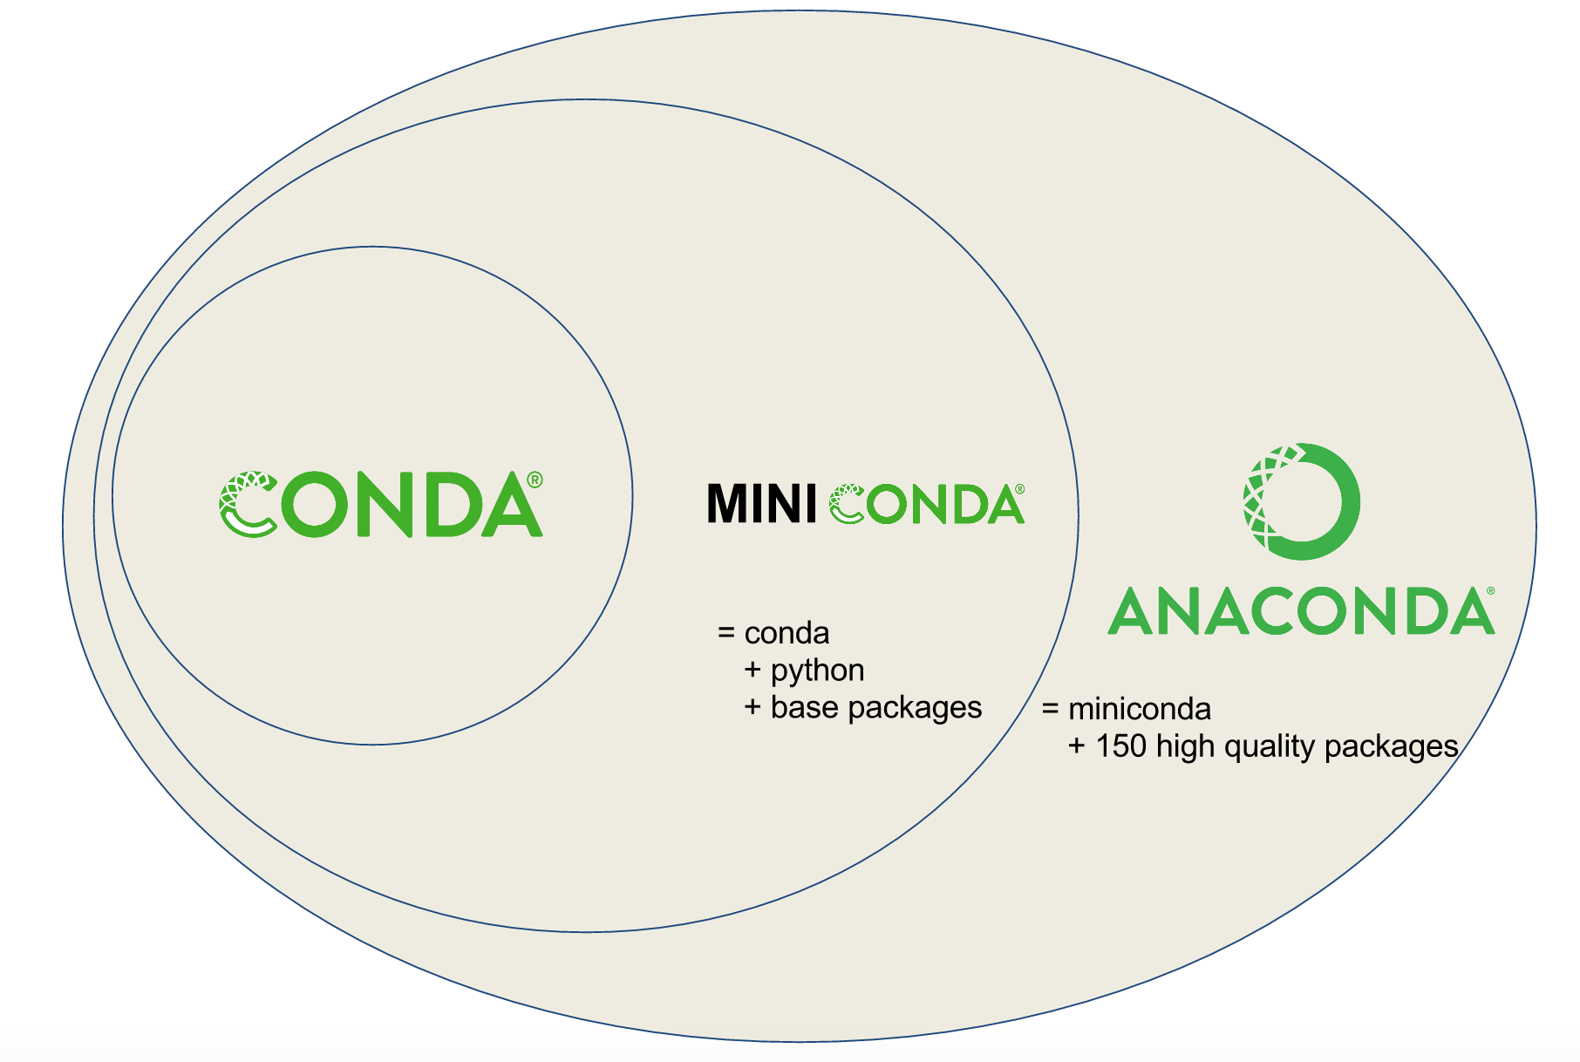
Conda package manager
Download and install the latest version of Miniconda3 from https://docs.conda.io/en/latest/miniconda.html.

Slide 15
What are the odds that you will eventually have a package dependency conflict?
Package A
version = 1.2
Package A
version >= 2.0
Package B
Package C
Python package dependency graph
https://kgullikson88.github.io/blog/pypi-analysis.html

Slide 16
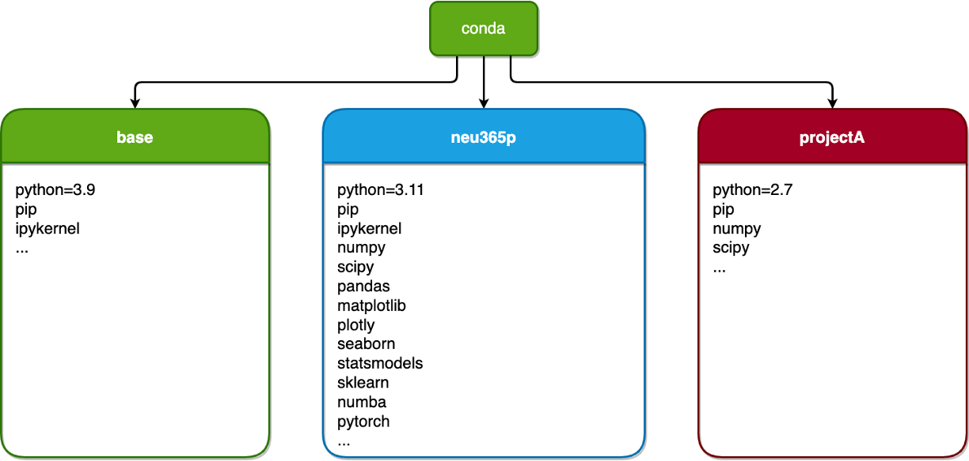
Environments

Slide 17


Conda package manager
conda –-help
conda create –n neu365
conda activate neu365
conda env list
conda install python
conda install numpy=1.24
conda install jupyterlab –c conda-forge
conda list
Show possible conda commands
Create neu365 environment
Activate neu365 environment
List all conda environments
Install python → neu365
Install numpy 1.24 → neu365
Install jupyterlab → neu365
List all packages in neu365

Slide 18
Your command line active Python interpreter
python –-version
which python
where python
Print version of active Python
Print location of active Python (Mac)
Print location of active Python (Win)

Slide 19
Interactive python from the command line
python
>>> print(“hi”)
hi
>>> 2+2
4
>>> exit()
Start interactive Python interpreter
Print the string “hi”
Add 2 + 2
Quit interactive Python interpreter

Slide 20

Run Python code from a file
myfile.py
x = 5.4
print(x * 2)
python myfile.py
Run the code in myfile.py

Slide 21


Jupyter Notebooks
conda activate neu365
conda install jupyterlab –c conda-forge
jupyter lab
Activate neu365 environment
Install jupyterlab → neu365
Run JupyterLab in your browser
Or some other development environment such as Visual Studio Code.

Slide 22
Learning goals – Python ecosystem
You will understand the role of the Python interpreter.
You will gain a rudimentary understanding of the Python ecosystem.
You will be introduced to the Conda package manager.
You will be introduced to Jupyter notebooks.

Slide 23

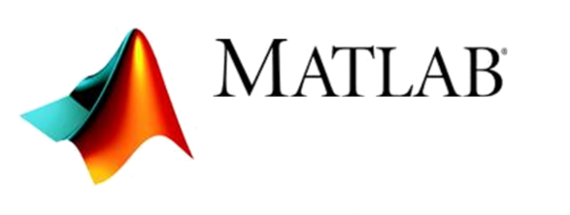
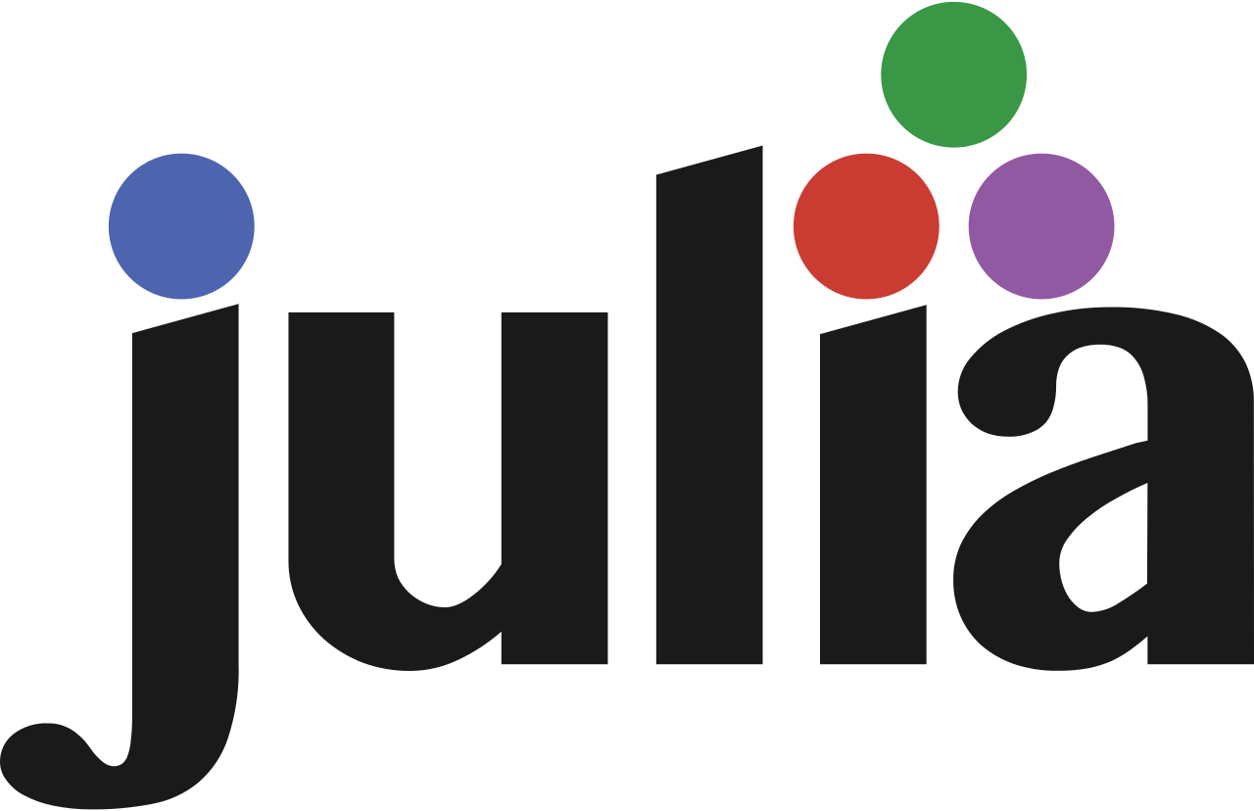
Some alternatives to Python

